Slide 1
SIMS
Group Members:
Ary Hernandez
Jacquelyn Johnson
Andrew Samuel
John Andrew Tomich
Julio Quintero

Slide 2
Group Type/Structure
Democratic:
Coined “egoless programming” where finding faults in the code is encouraged.
Mutual respect is crucial
Advantages:
Positive attitude towards progressing the project
High productivity
Works well to come together to fix a hard problem

Slide 3
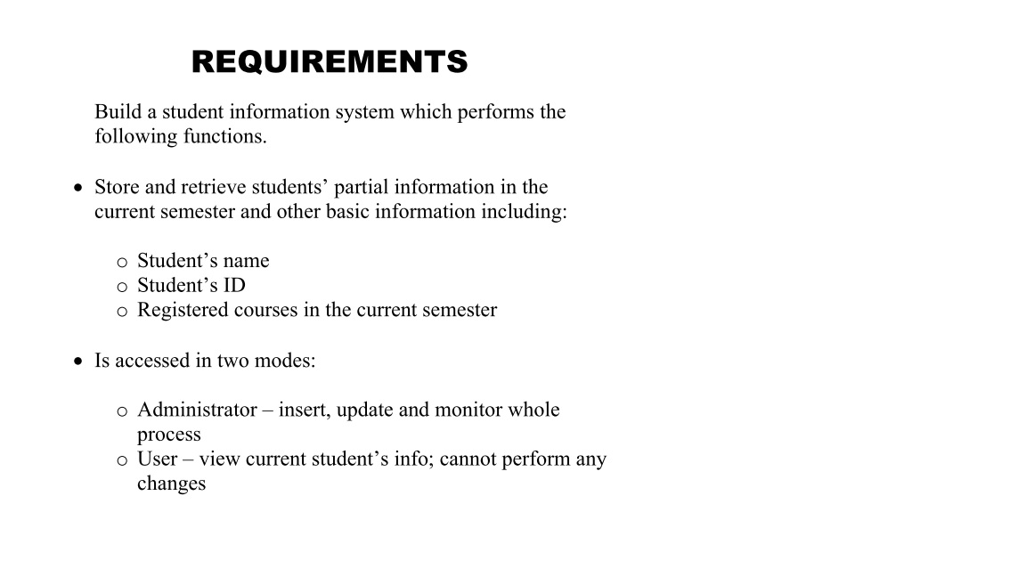
Requirements Documentation

Slide 4
Use-Case Diagram

Slide 5
CRC Description
Below you will see a description of the CRC cards with class descriptions used to design our project software.

Slide 6
mainFrame
Responsibilities | Collaborators
This class is responsible for holding the main frame requiring every user to insert an ID and password to login | This class accesses the Db class and sends data to the Student and AdminFrame classes

Slide 7
Student
Responsibilities | Collaborators
This class receives a value from mainFrame that it uses to display the needed information from the database. Can return to mainFrame class when done viewing | Accesses information from mainFrame and calls needed information from Db

Slide 8
Db
Responsibilities | Collaborators
This class makes connections to the database that holds all user information | This class is called by mainFrame, AdminFrame, and Student.

Slide 9
Login
Responsibilities | Collaborators
This class implements the methods to perform password validation, GPA calculation, and course registration (adding and deleting) | This class is called by mainFrame and AdminFrame

Slide 10
AdminFrame
Responsibilities | Collaborators
This class displays a frame where the admin can view and modify student info with options to add or delete classes and to modify grades | This class is called by mainFrame and accesses the Db and Login class.

Slide 11
Workflow Implementation
Below you will see how we implemented the 5 workflows

Slide 12
Requirement Workflow

Slide 13
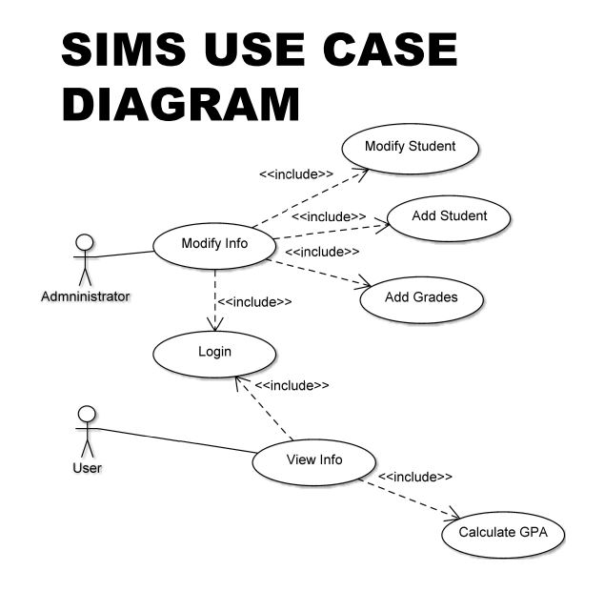
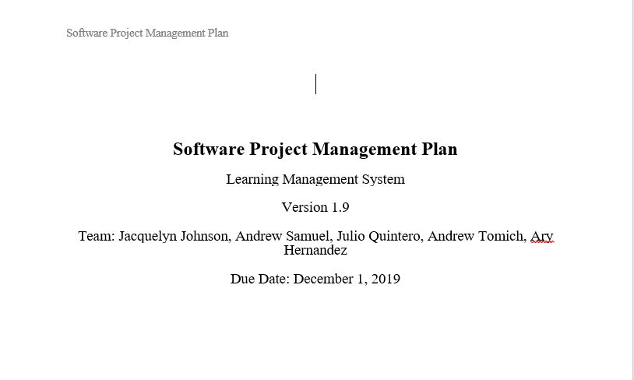
Analysis Workflow

Slide 14
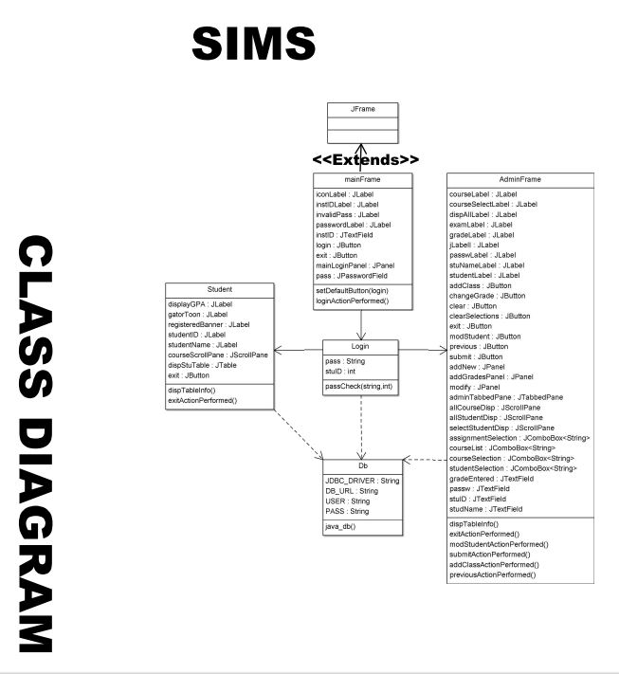
Design Workflow

Slide 15
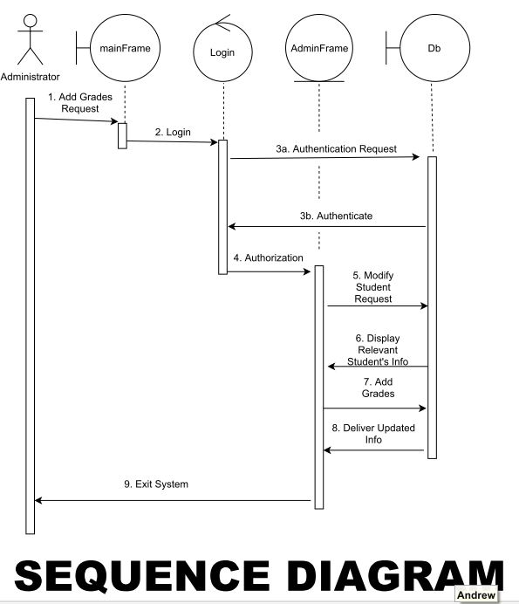
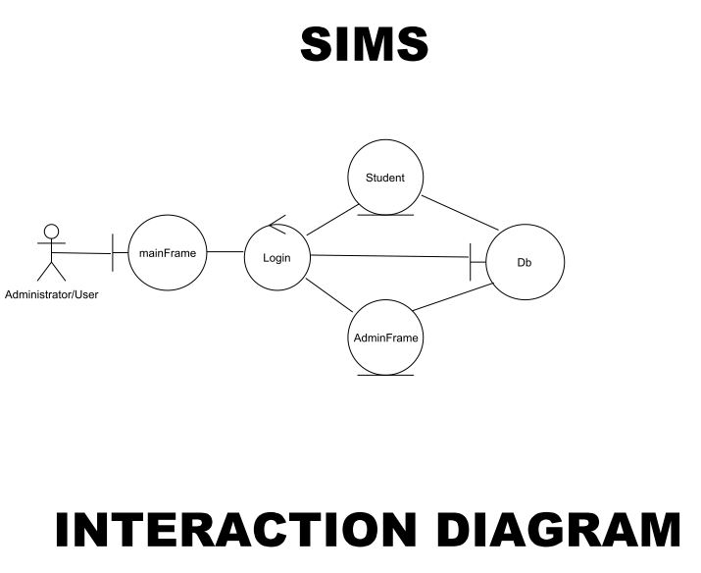
Implementation Workflow

Slide 16
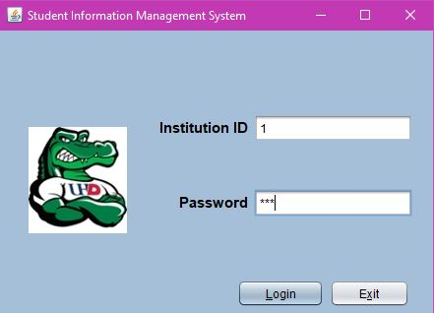
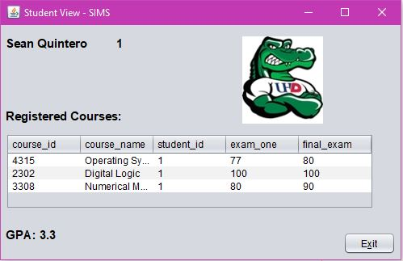
Test Workflow - User

Slide 17
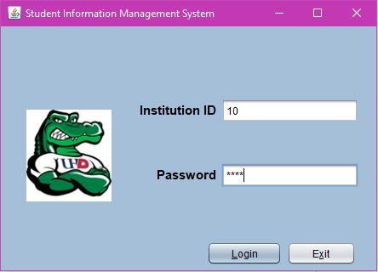
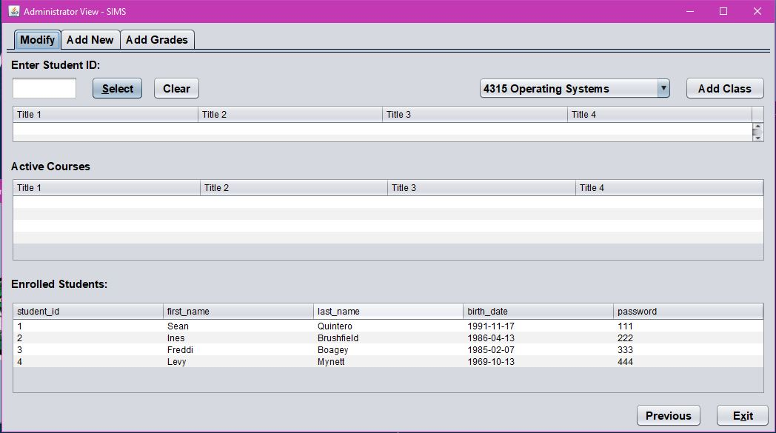
Test Workflow - Administrator

Slide 18
Code Description
We coded in Java for the GUI/Front End using Netbeans and Eclipse as IDE(s) and for the Back End/Database we used SQL (specifically mySQL)using mySQL Workbench as the IDE
Click me to view SIMS

Slide 19
Thank You

